Slide 1
RFID BASED ATTENDENCE MONITORING
TECHNICAL PROFICIENCY & TRAINNING

Slide 2
AIM
The project is amide to interfacing RFID to nodemcu,
to take STUDENT ATTENDENCE AUTOMATICALLY.

Slide 3
COMPONENTS Required
NodeMCU
MFRC522 RFID Reader
RFID Tags ( 13.56 MHz )
Bread Board
Jumper Wires
LEDS

Slide 4
Working Principle
Radio-Frequency Identification (RFID) is the use of radio waves to read and capture information stored on a tag attached to an object.
A RFID reader is a device used to gather information from an RFID tag, which is used to track individual objects.
Radio waves are used to transfer data from the tag to a reader.
A passive tag is an RFID tag that does not contain a battery, the power is supplied by the reader. When radio waves from the reader are encountered by a passive RFID tag, the coiled antenna within the tag forms a magnetic field.
The tag draws power from it, energizing the circuits in the tag

Slide 5
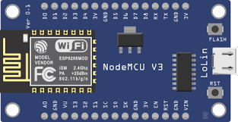
NODEMCU
The NodeMCU (Node MicroController Unit) is an open-source software and hardware development environment built around an inexpensive System-on-a-Chip (SoC) called the ESP8266.
ESP8266 is also hard to access and use. You must solder wires, with the appropriate analog voltage, to its pins for the simplest tasks such as powering it on or sending a keystroke to the “computer” on the chip.
The prototyping hardware typically used is a circuit board functioning as a dual line package(DIP) which integrates a USB controller with a smaller surface-mounted board containing the MCU and antenna.

Slide 6
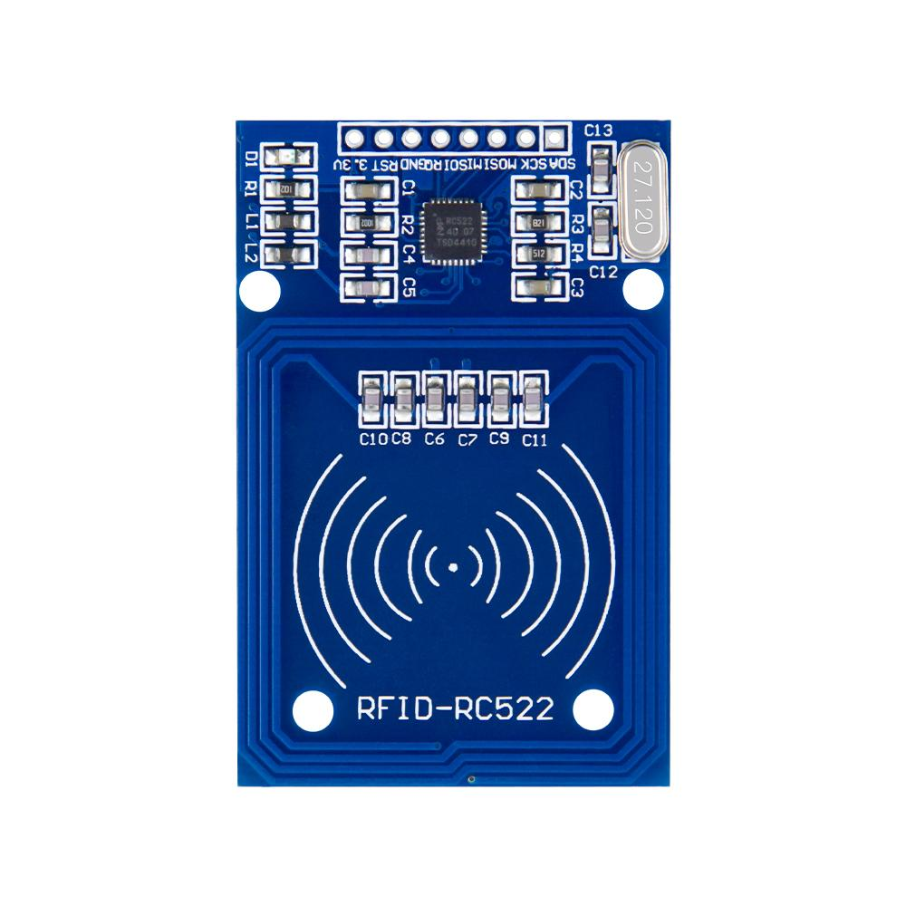
Rfid Module
> Radio-frequency identification (RFID) uses electromagnetic fields to automatically identify and track tags attached to objects.
> An RFID system consists of a tiny radio transponder, a radio receiver and transmitter.
> When triggered by an electromagnetic pulse from a nearby RFID reader device, the tag transmits digital data, usually an identifying inventory number, back to the reader.
> Unlike a barcode, the tag does not need to be within the line of sight of the reader, so it may be embedded in

Slide 7
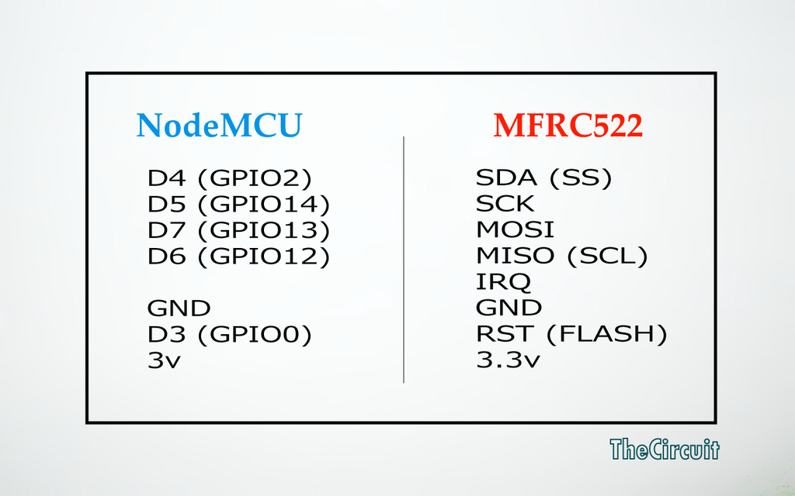
PIN WIRING

Slide 8
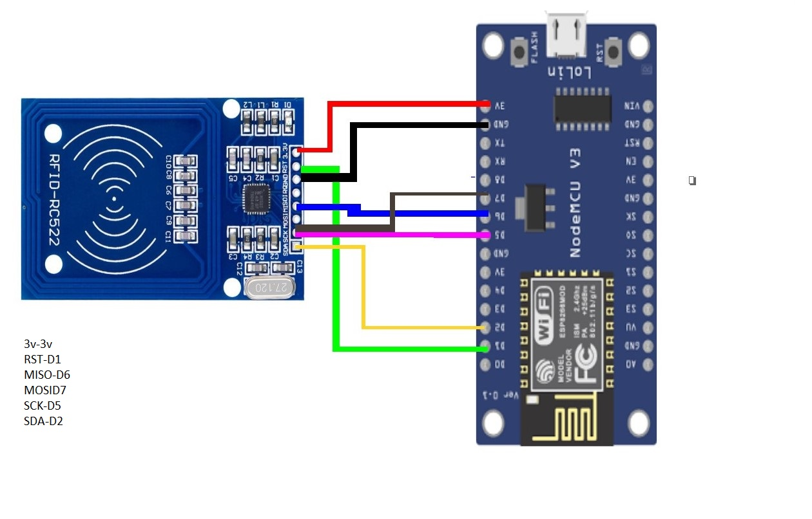
CIRCUIT DIAGRAM

Slide 9
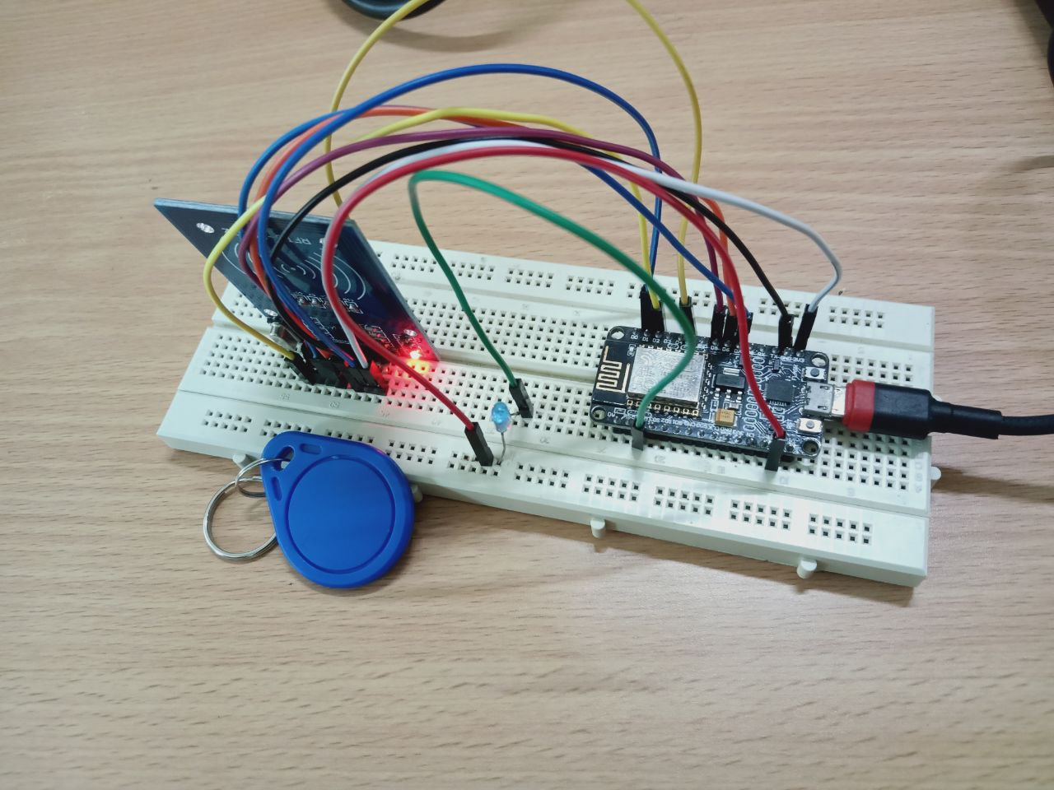
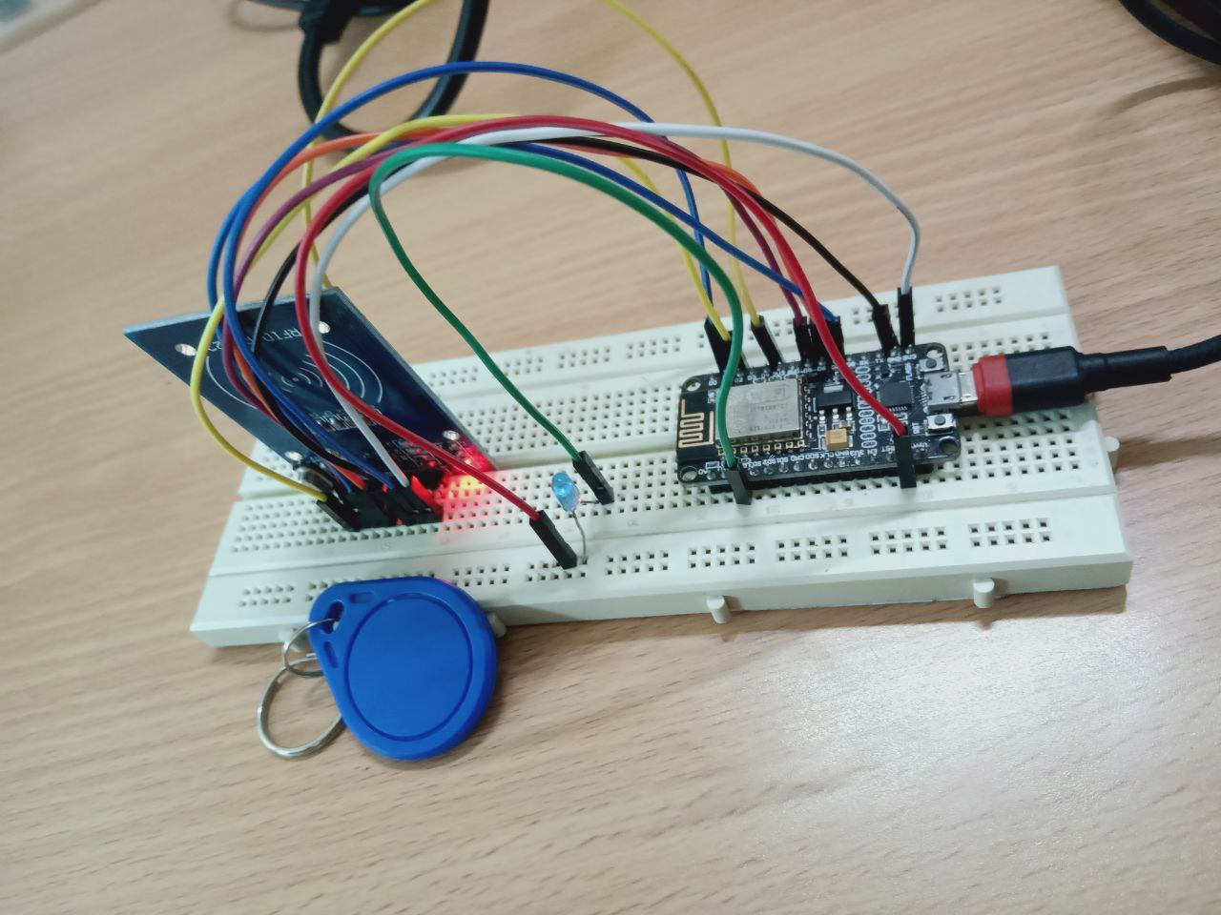
OUTPUT

Slide 10
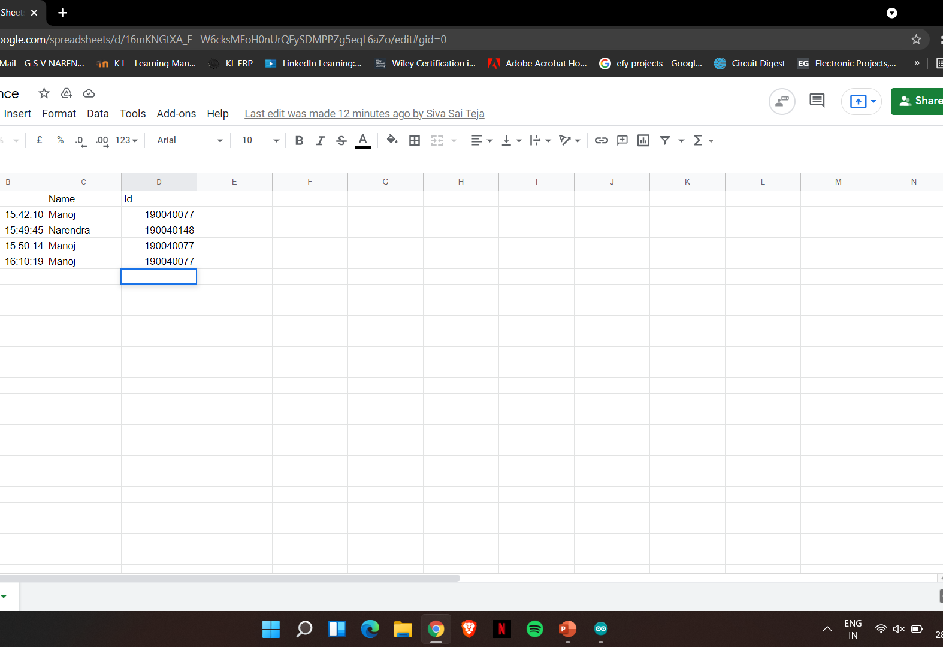
Google sheet
Auto updation

Slide 11
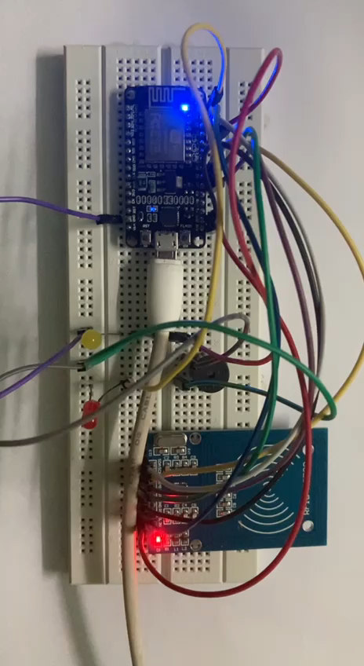
Simulation Output video

Slide 12
THANK YOU

